Slide 1
An Enterprise on Fire: Successful Strategies in Triage
K “Turb0Yoda” Singh “Bluescreenofwin” AKA Michael Glass

Slide 2

About K
Senior Operations Team Member
Consultant at CrowdStrike
Past Consultant and Lab Manager at Cylance
E-Disco and Forensics at Kaiser Permanente
Audio Addict and broke Mechanic

Slide 3
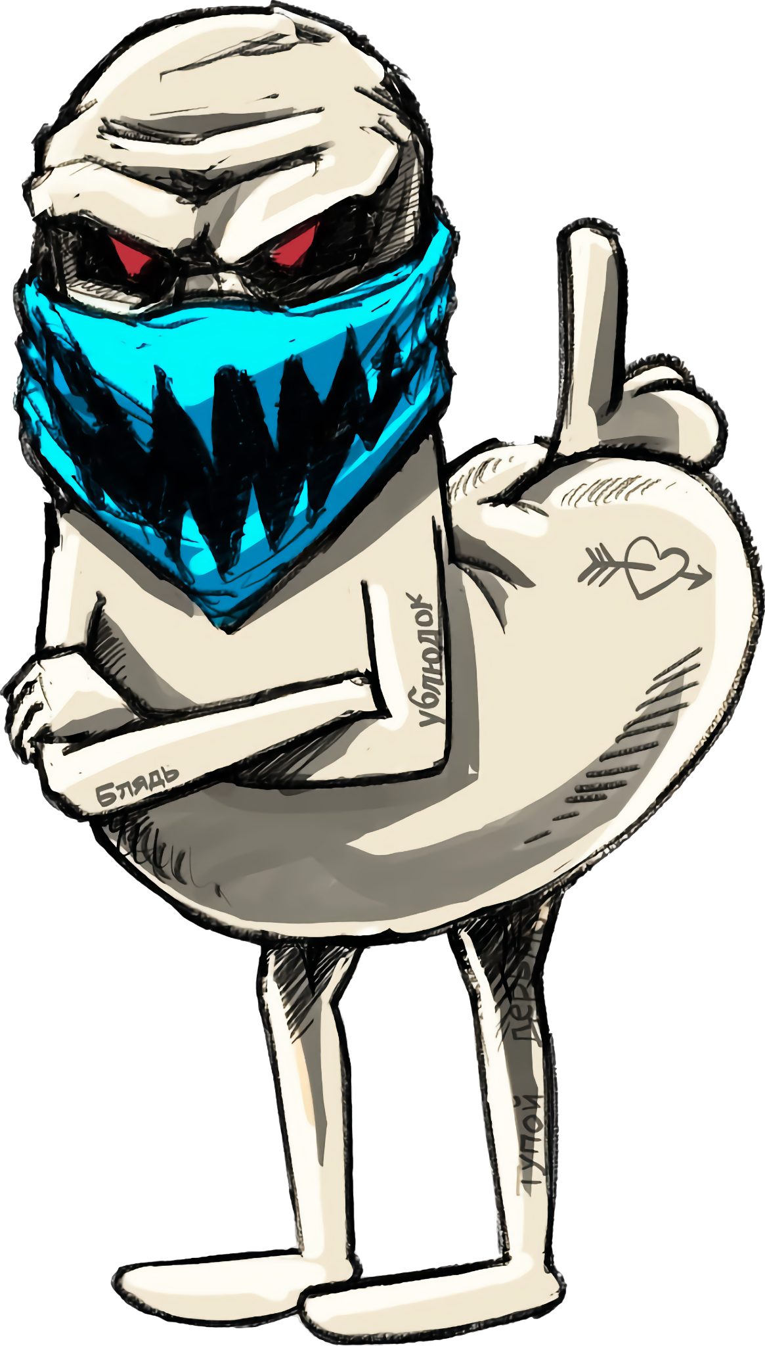
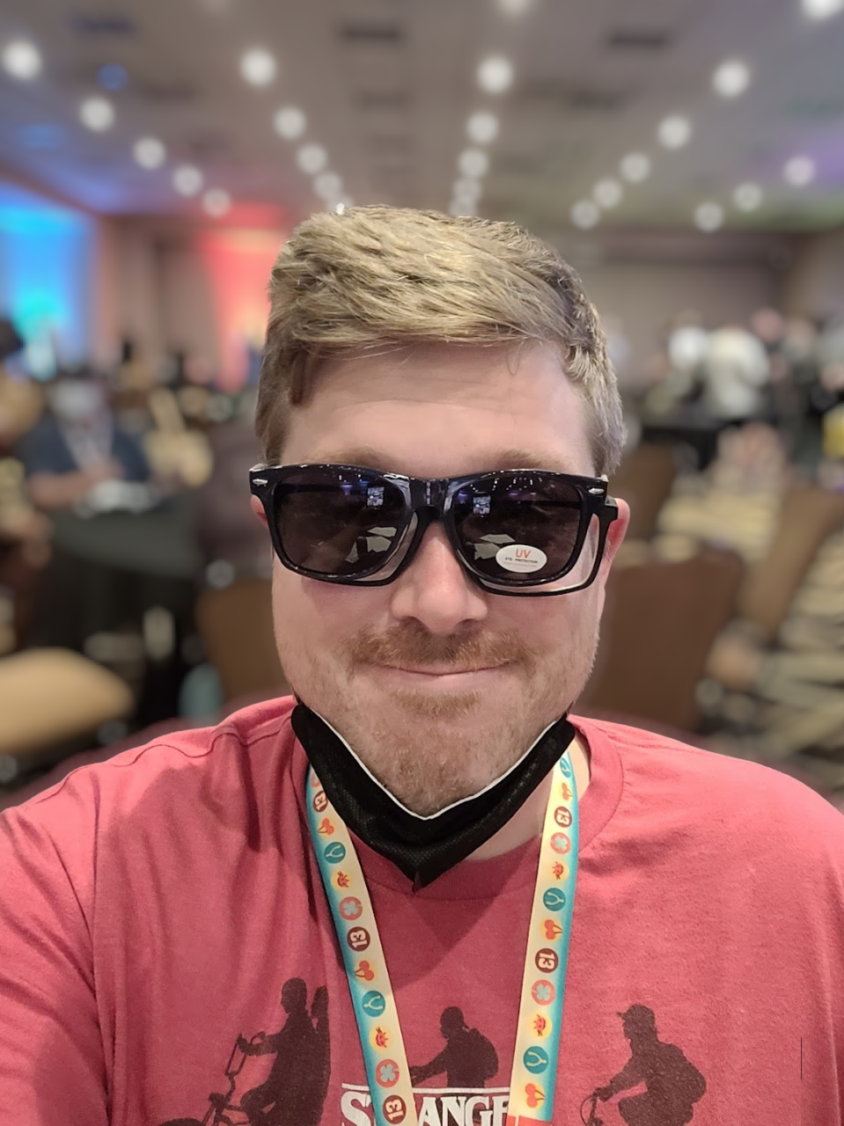
About Bluescreenofwin
Aka Michael Glass
Infrastructure lead at WRCCDC
Senior Security Engineer/Operations Manager for adult websites
(yes those adult websites)
Designer of security competitions
Brewer of beer

Slide 4
Preliminary Research
First time collecting data from the competition
Hopefully with many more years to come
Process of continuous improvement
Enjoy!

Slide 5
Let’s Begin!

Slide 6
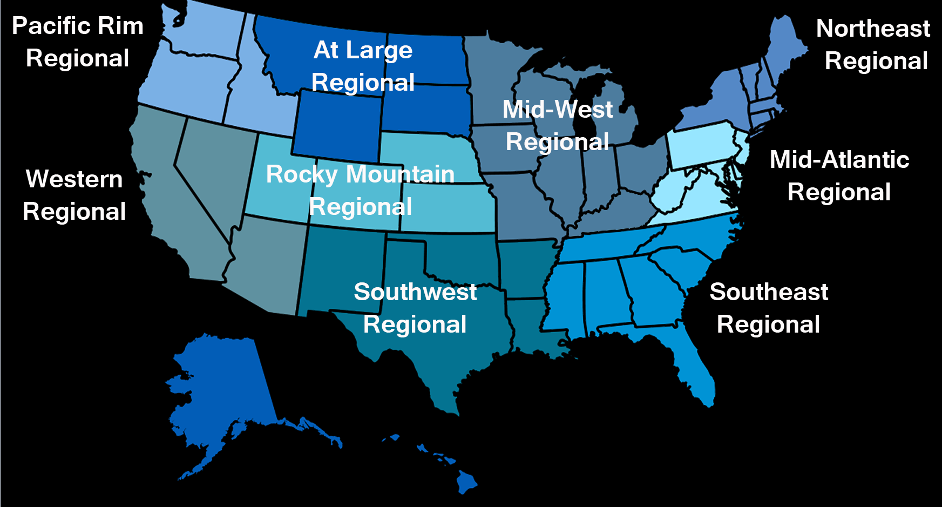
What is a CCDC?
Collegiate Cyber Defense Competition
https://www.nationalccdc.org/
https://www.wrccdc.org/
9 Regions, all college students
Team of 8 blue-teamers try to survive against seasoned red-teamers
Winners of the regional go to nationals to compete against other region winners

Slide 7
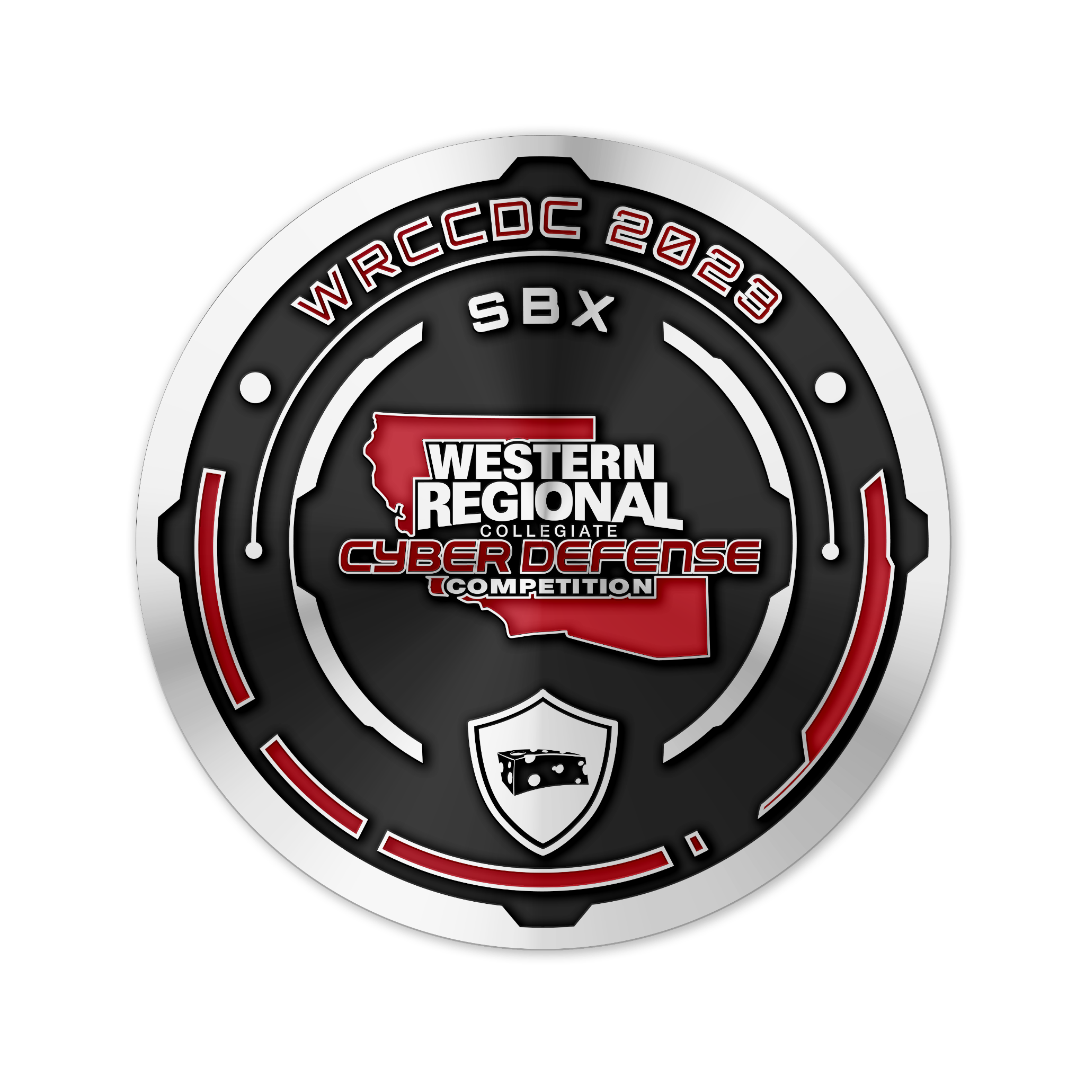
How to CCDC?
A “fully functioning business”
Many services that must be maintained and secured
Students are given various injects to complete, along with hardening systems and ensuring uptime does not fall below SLA levels
IR is encouraged to recover lost points due to RT activity
WRCCDC 2023 Challenge Coin
Designed by Bluescreenofwin ;D

Slide 8
This is a Defense Competition, not an Incident Response Competition

Slide 9

The Competition

Slide 10
The Competition

Slide 11
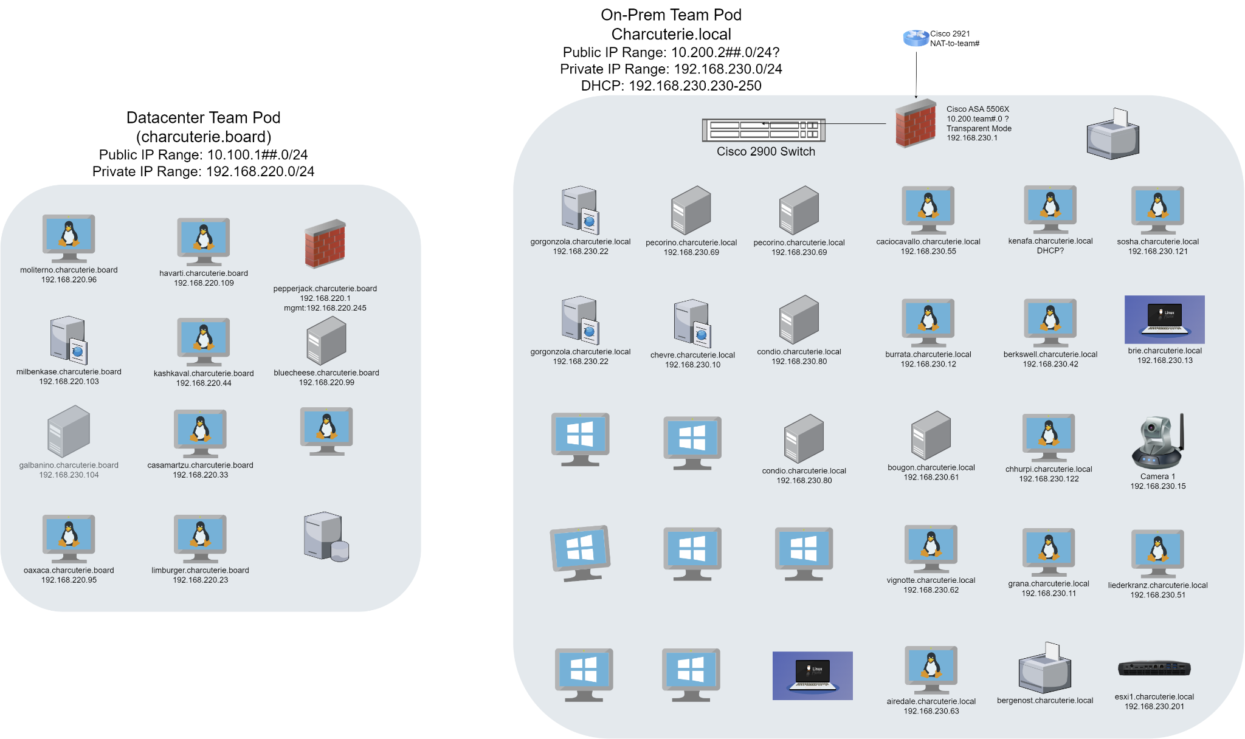
Student Environment Hosted in Colo

Slide 12
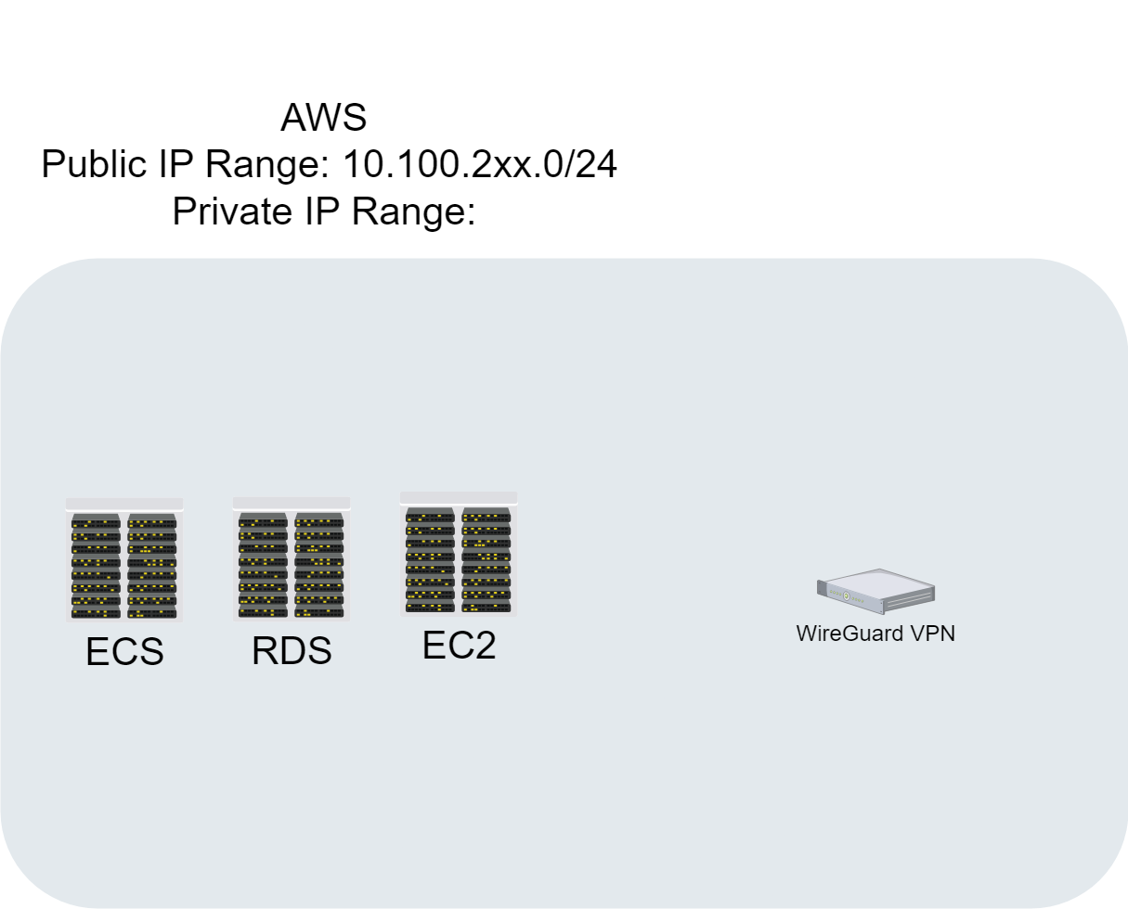
AWS Student Environment
Students had Lambda as well (and a myriad of containers)

Slide 13
Environment Breakdown (Per Team)
Total Teams: 10
# of Environments: 4 (Colocated, AWS, local virtual, and physical infra)
Total Laptops: 10
Total Servers: 27 (some host multiple services)
Total Scored Services: 32 (many more unscored and vulnerable)
Total Self-Managed VMs/Containers: 20~
Total Misc. Hardware: 2 Cameras, 2 NUCs (hosting ESXi), WiFi Router (WiFi in scope), and a thermal printer (lol)
Network Equipment included: 1x Cisco ASA, 1x Cisco Switch, 1x Cisco FTD, 1x Palo Alto Firewall

Slide 14
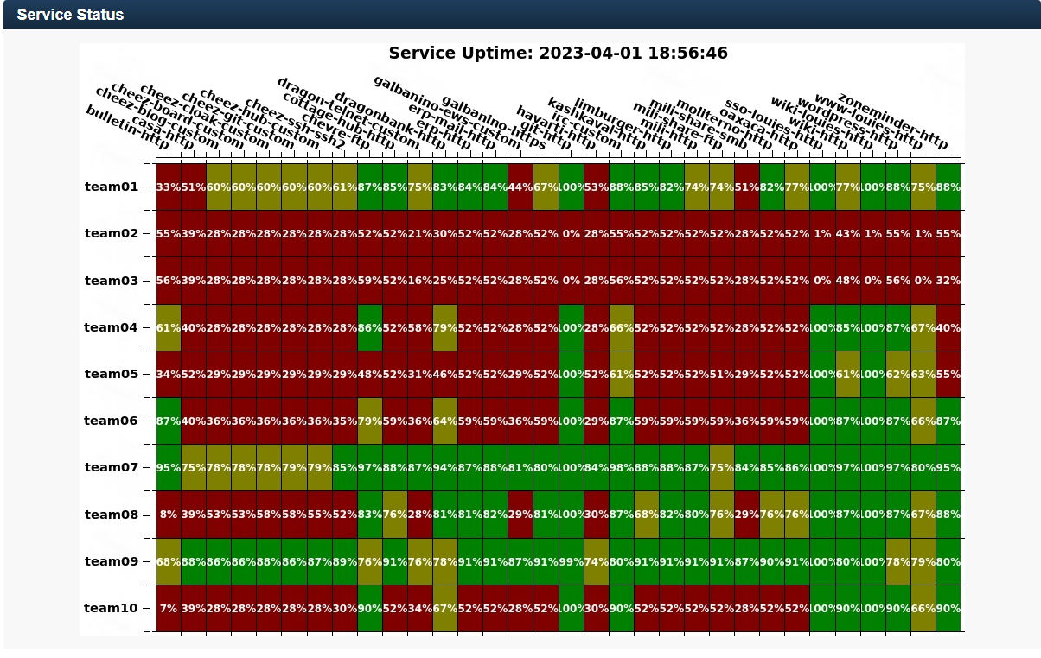
Service Uptime (end of competition)

Slide 15
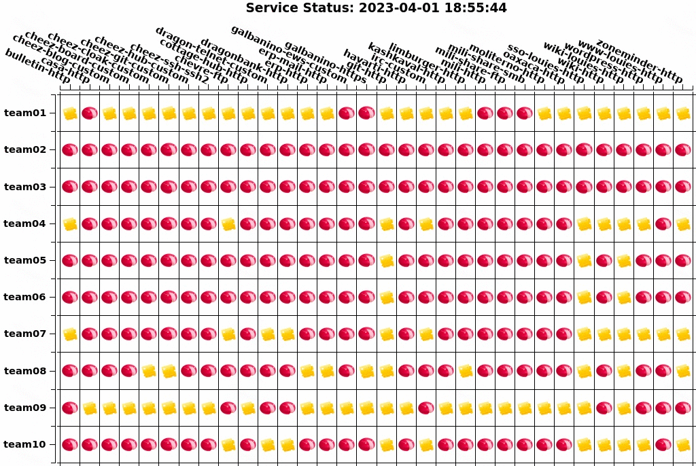
Service Status (end of competition)

Slide 16
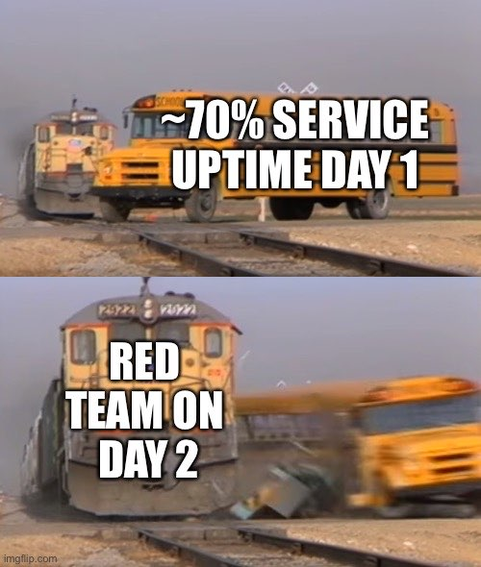

Slide 17
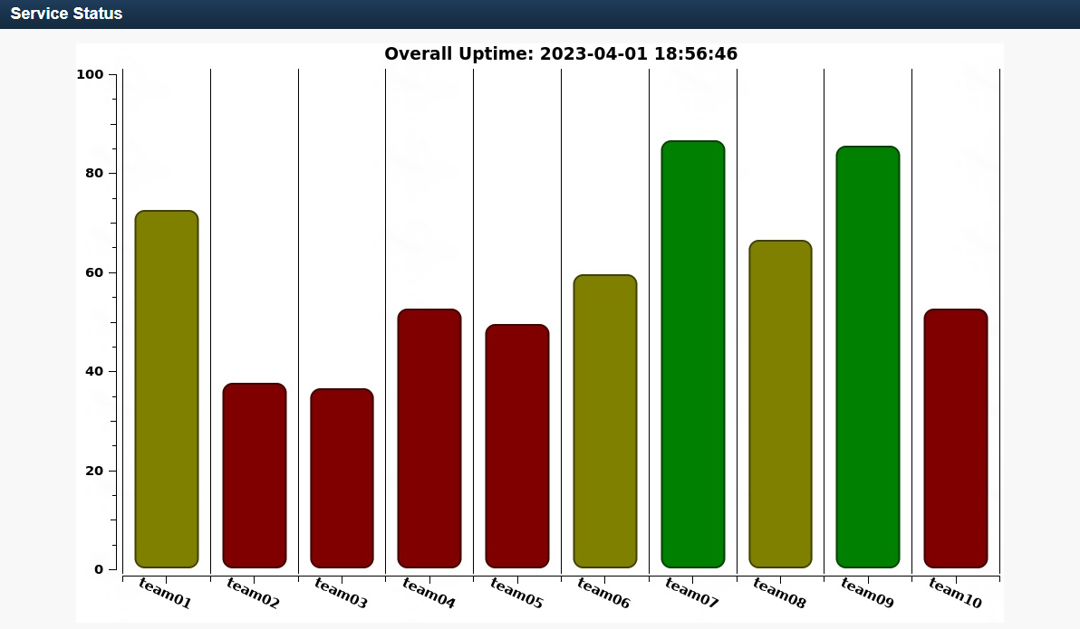
Overall Uptime (end of competition)

Slide 18
The Collection Process

Slide 19
The real world is not as pretty as people think
Dropping in as a consultant - we see many environments that are held together with string
Primarily out of date Operating Systems and clobbered together applications
No AV/EDR/XDR/magic, and no SIEMs
Threat Actors do not see boundaries when getting into a network, neither does our red team
Expectation of supporting the client team during the length of the engagement

Slide 20
The steps we take to have fun emulate life
Operating Systems aren’t the latest and greatest
Who wants to risk updating the main database with no backups?
Competitors get some background info similar to a kick-off call, and are thrown into the environment
Injects are sent out at different time intervals for different tasks
Set up SIEM, give presentation, update website, etc
Red Team doesn’t stop until it’s beer o’clock

Slide 21
Methodology
Two key systems picked for analysis across the competition
Bluecheese - Windows Domain Controller
Oaxaca - Primary Wordpress site on Linux
Snapshots taken every 30 minutes throughout the competition
Six snapshots selected, spanning the two-day course of the competition to analyze
Four on Day One, Two on Day Two

Slide 22
Collections & Analysis
SANS Triage KAPE Collection for Windows via Velociraptor
88GB of KAPE
CyLR Linux Collection
8GB of CyLR
No Velociraptor due to SysV
We black teamed ourselves
Log2Timeline -> Timesketch
One Nissan Versa gifted to AWS for chonky EC2 instances
91GB of plaso files
1,693,060,304 artifacts indexed
Notes:
Credit to Ryan Chapman and FOR528 and SANS

Slide 23
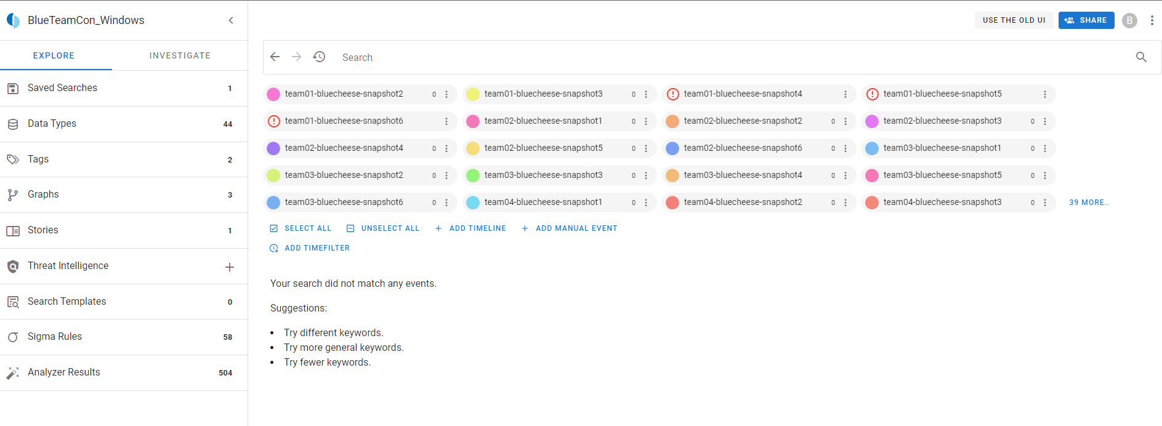
Timesketch

Slide 24
Red Team Trends

Slide 25
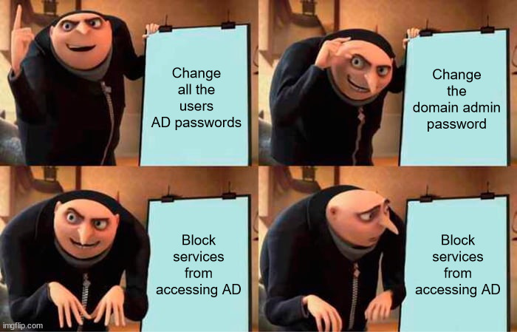
Red Team Tactics - Windows
Cobalt Strike Beacons everywhere
Classics like ZeroLogon and EternalBlue used extensively
Disabling UAC and Windows Defender
SSH installed by Red Team onto a majority of boxes
Basic anti-forensics eg event log clearing

Slide 26
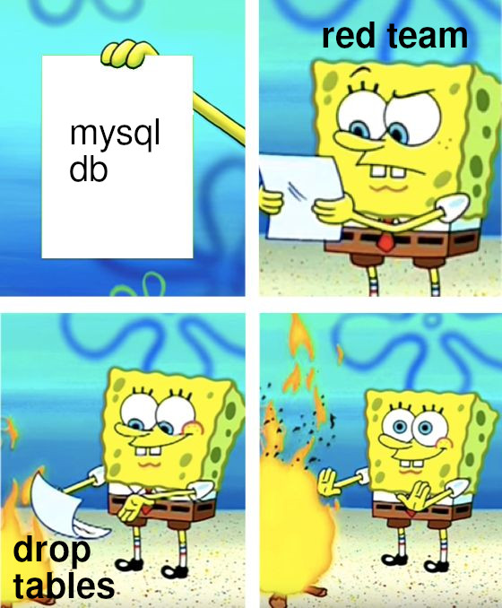
Red Team Tactics - Linux
SSH Bruteforce
Default Credentials
Application breakouts & exploits

Slide 27
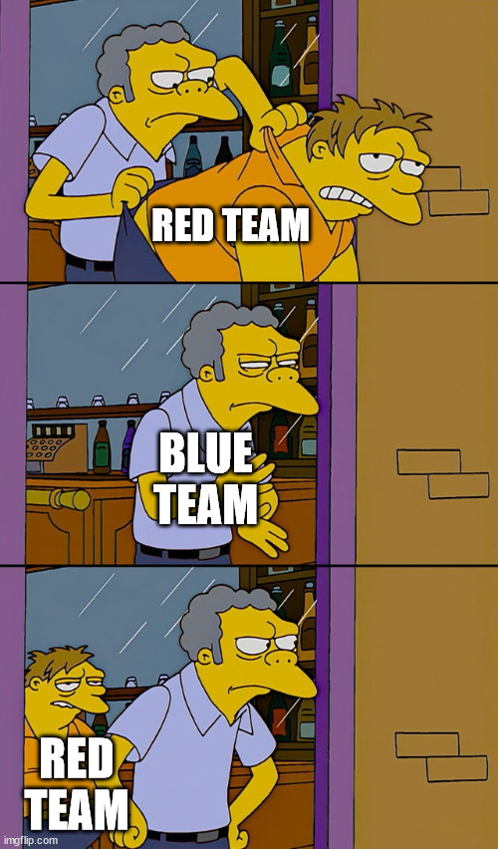
Red Team Trends
Let’s start with what we know
Red team is lazy
They want easy shells
K.I.S.S
When calculating scoring at the end of the competition
56% of point deductions were default credential reuse

Slide 28
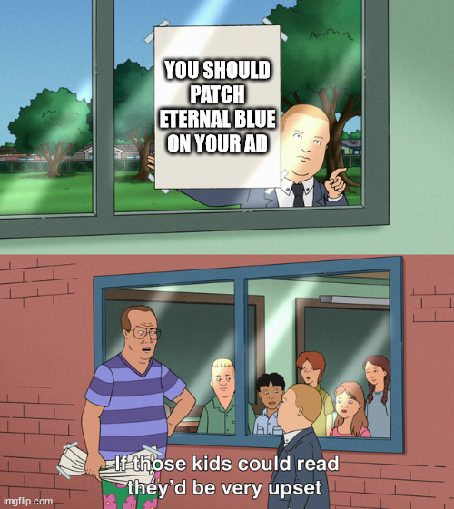
Red Team Trends
What did we observe with the data
Initial compromise of the environment was exclusively EternalBlue
Default credentials for all the things
This continued throughout the entire 2 day competition

Slide 29
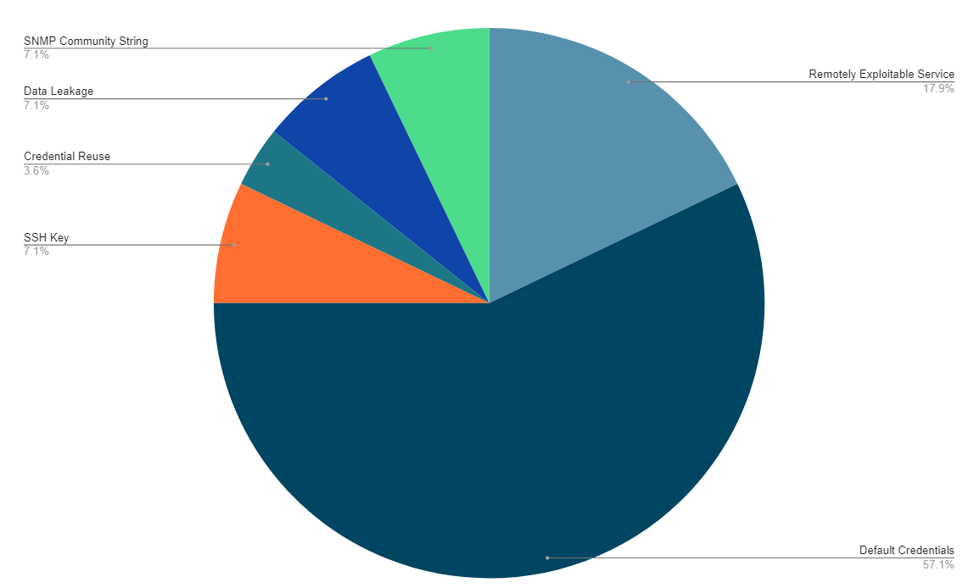
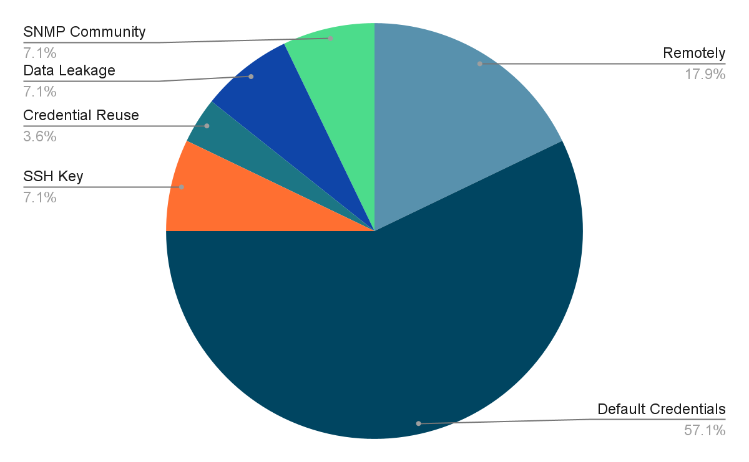
Total Red Team Deductions by Attack Vector

Slide 30
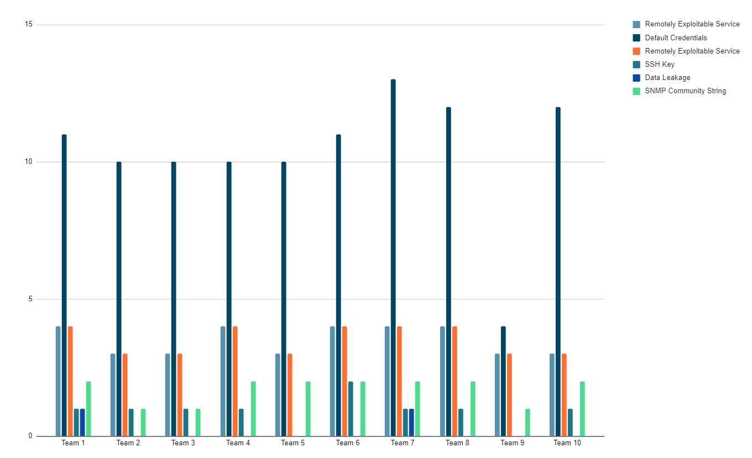
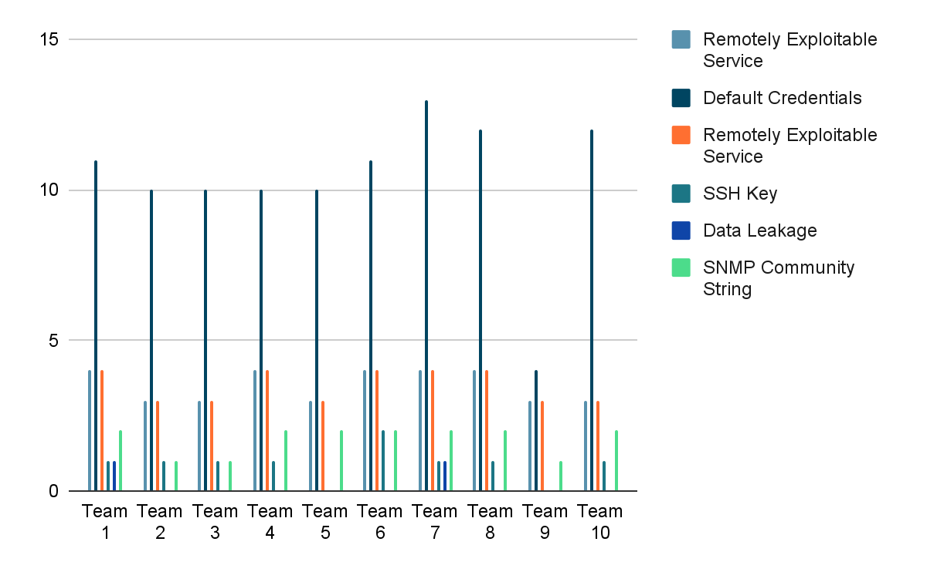
Points Deduction Spread by Team
Notes:
Outlier here is Team 09 in Default Credentials

Slide 31
Blue Team Trends

Slide 32
Blue Team Trends

Slide 33
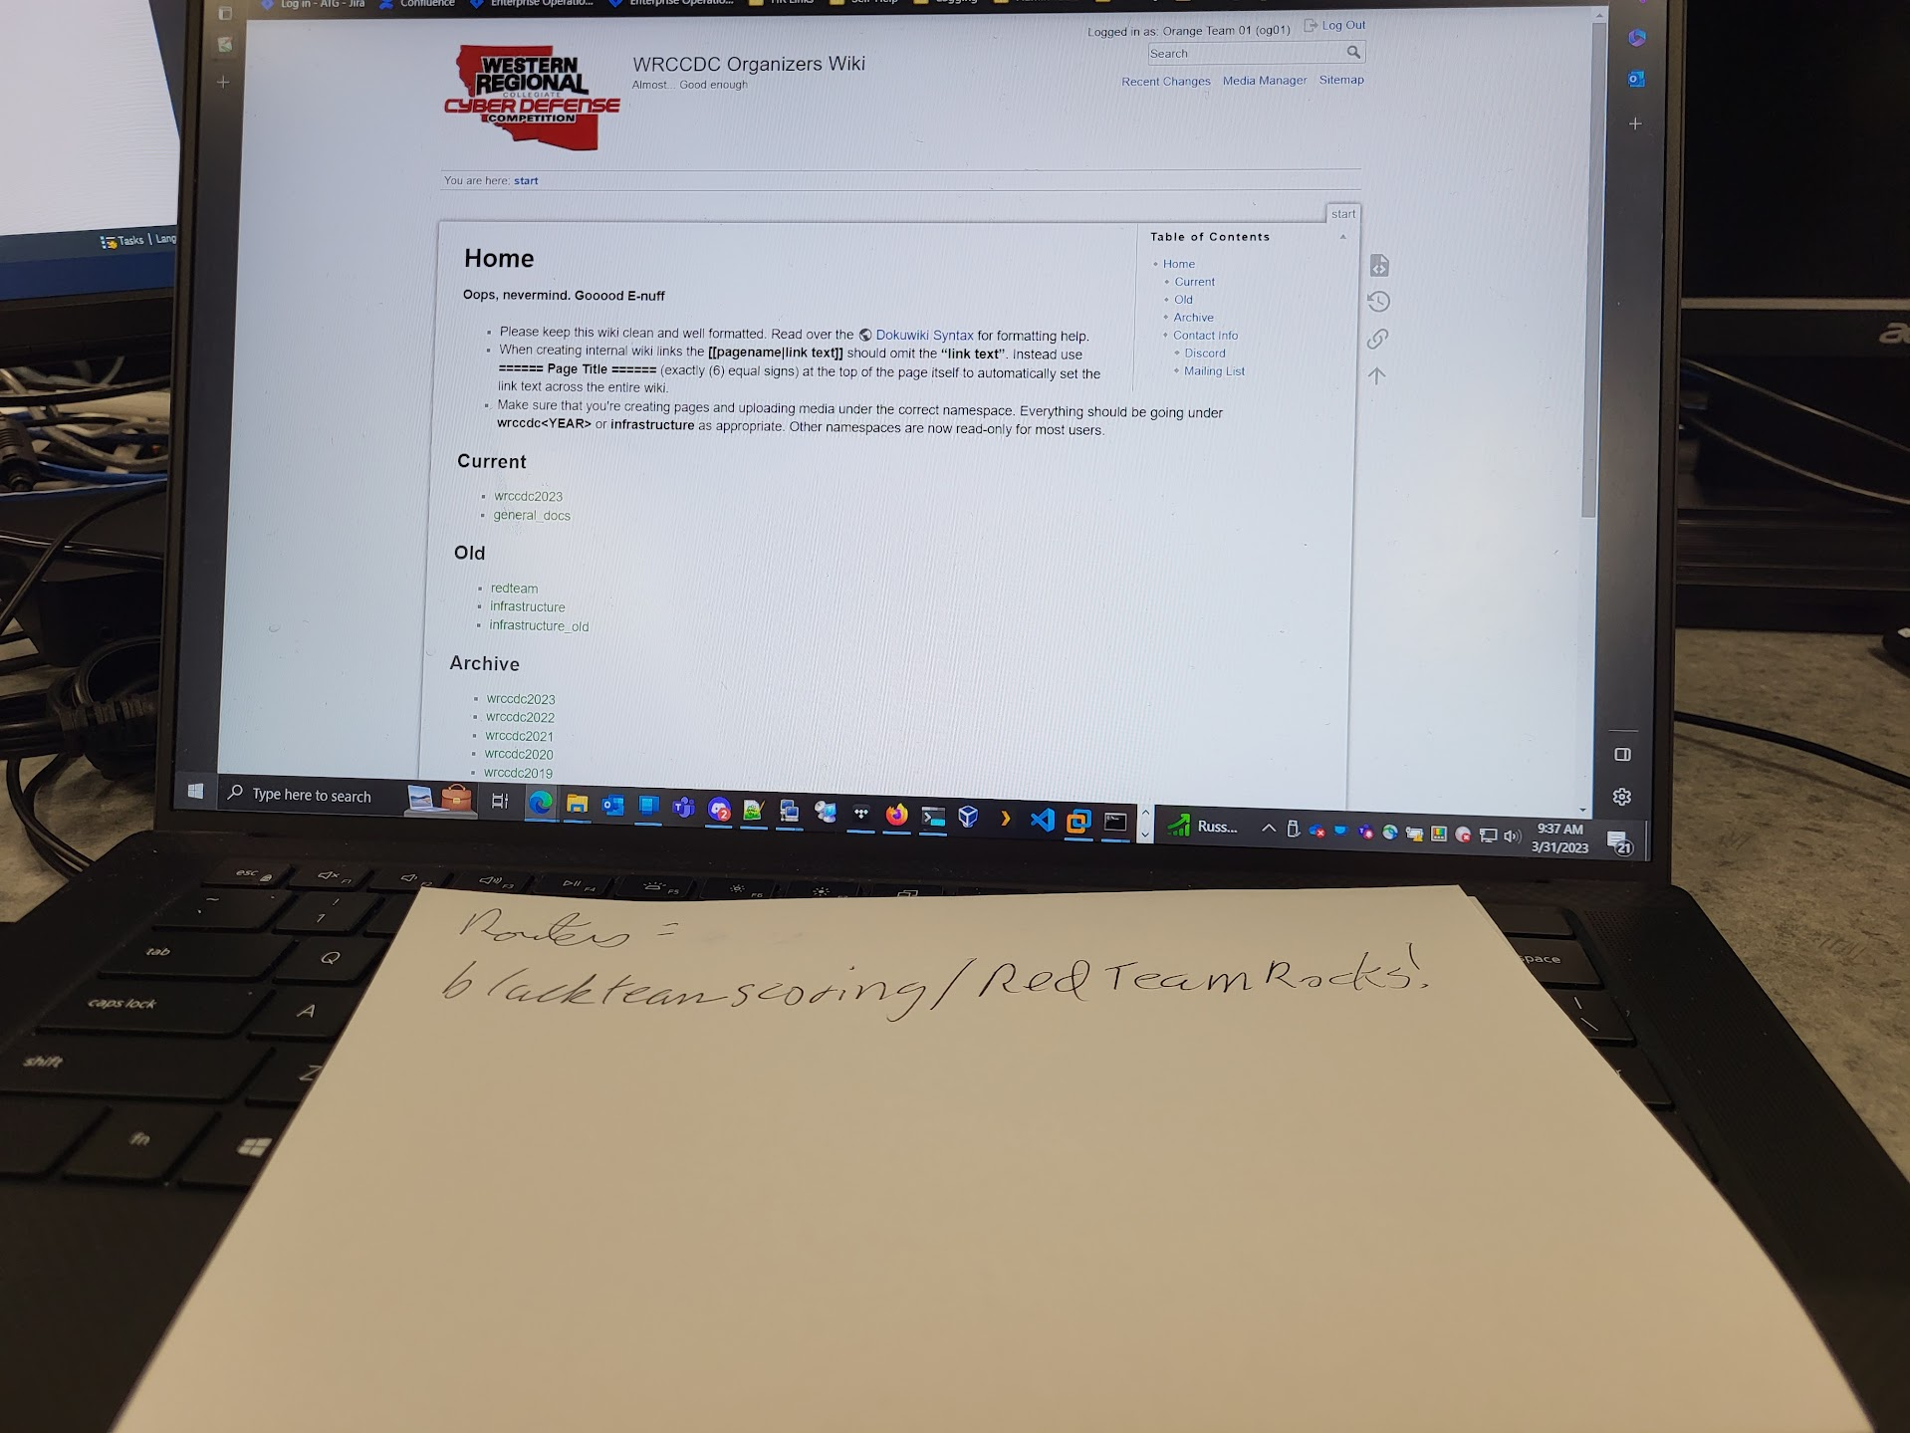
Blue Team Trends
Everyone got popped
Red team compromised every environment within the first five minutes of the competition
Ops team lost backdoor access into the boxes as well
RT gracious enough to recover our access

Slide 34
Blue Team Trends
Finding: Only 1 team consistently rotated default credentials
Reasons may include
Teams resetting back snapshots after being owned
Lack of time/stress
Bad practices

Slide 35
Blue Team Trends
Finding: Teams which frequently scrutinized firewall rules did not rank high in overall score or defense
Sigma Rule
Firewall configuration enumerated (PowerShell)

Slide 36
Blue Team Trends
Finding: Top performing teams used “red team” tools to observe their threat landscape and learn how bad actors can see their environment
Sigma Rule(s):
Massive SAM users/groups enumeration (native)
Sensitive SAM domain user & groups discovery (native)
Notes:
\

Slide 37
Blue Team Trends
Finding: Only 1 team used Sysmon
The team that took first place overall used Sysmon
Team 07
The team that placed first in overall defense did not use Sysmon
Team 09

Slide 38
Blue Team Trends
Finding: Type of training had no impact on placement
The team that took first place overall used unstructured and informal training
Team 07
The team that placed first in overall defense used structured and formal training
Team 09

Slide 39
Blue Team Trends
Finding: Best practices not specifically trained
When surveying the teams none specifically trained best practices
Teams consider it important overall not for the competition

Slide 40
What the Top Blue Teams did right
Top teams enumerated domain for malicious accounts
Top teams also rotated credentials early on
Enumeration of all systems in the environment
Not everything is revealed to the teams at the onset of competition
Students get an idea of what is in scope but not many of the details
Usage of Wazuh or Graylog as a SIEM
Usage of Velociraptor, Sysmon, and other tooling

Slide 41
What Blue Teams did Wrong
No rotation of credentials for both Operating Systems and Hosted Services
A large portion of teams did not use any sort of event log management or AV/EDR
Little management of the Forest itself
GPOs, accounts, etc were all neglected
Over-reliance on “Box-Resets”

Slide 42
The Real World

Slide 43
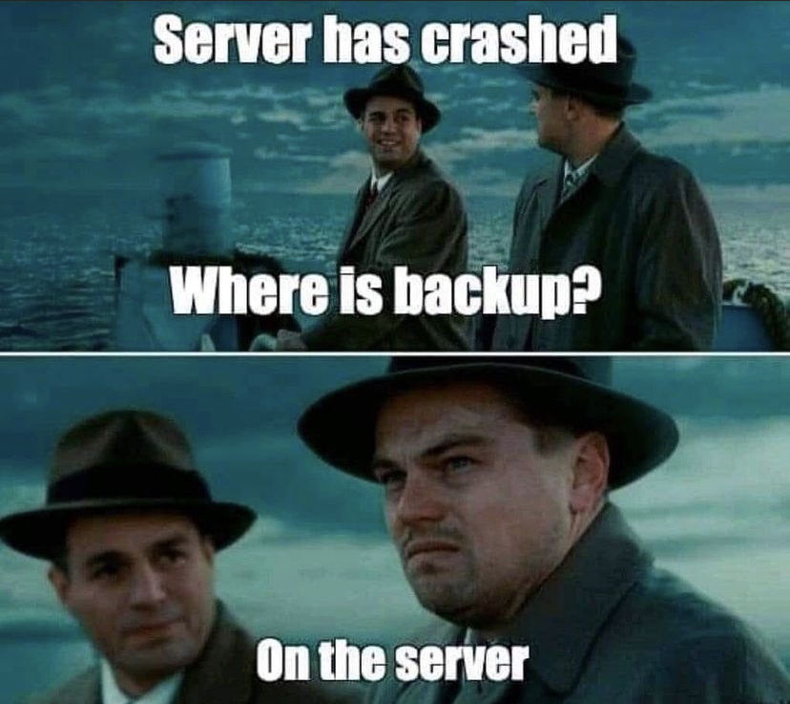
Industry parallels
Organizations with AV/EDR capabilities have greater resilience during a breach
A SIEM or other method to storing logs allows for easier lookback post-breach
Ability to do rapid Incident Response slashes response time

Slide 44
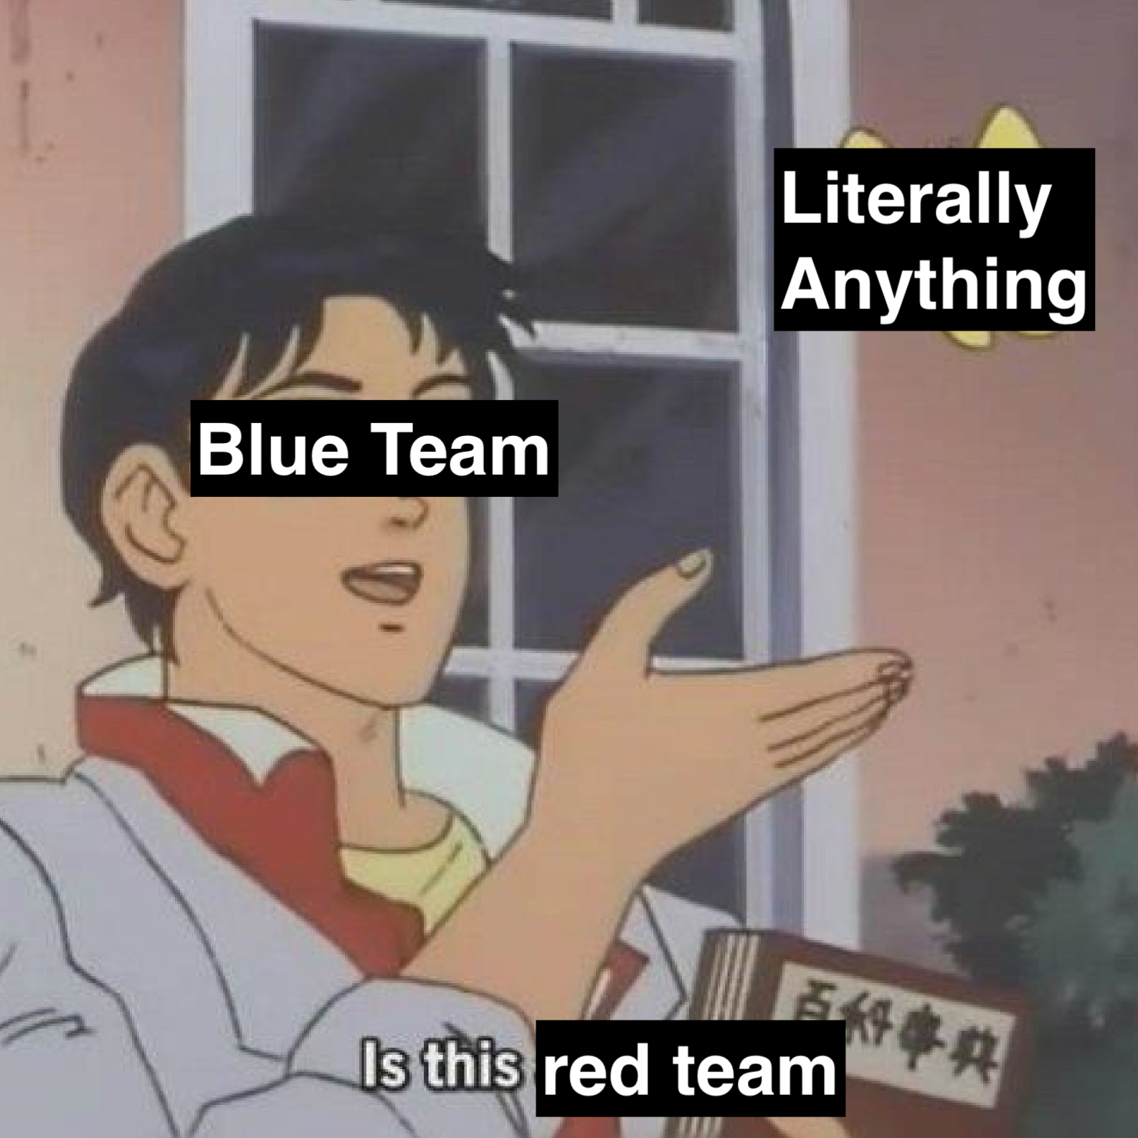
More (Depressing) Industry Parallels
Weak credential policy is heavily prevalent in a lot of organizations
Password Policy, Accounts being unnecessarily privileged, Hidden admin accounts
Lack of centralized logging solutions or proper deployment of tooling
Some systems have the latest and greatest, some have nothing
“Tech Rot” leads to a large number of unknown devices tromping around the network

Slide 45
Having a better SLA than Comcast
Uptime, as well as handling requests from business stakeholders, was held up by whether blue teams spent time hardening and learning the infrastructure
Teams who did not do the basics like rotation of credentials and enumeration of the environment lost out with uptime scoring
On the flip side- some teams spent too much time preparing for the stakeholders and not enough hardening systems.

Slide 46
Customer Service at it’s finest
Professionalism matters when working with clients/company stakeholders
Relaying technical information to an audience with a varied background is critical to keeping communications active between groups
Poor and unruly communications lead to broken relationships and trust
Teams who stayed professional in all communications stood head and shoulders above those who were semi-professional or casual

Slide 47
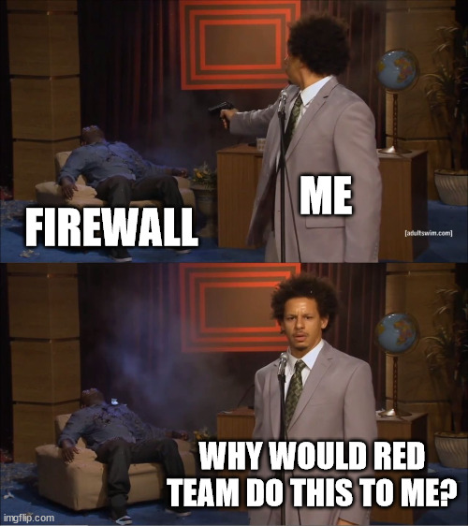
Top Three Strategies
Basic Building Blocks
Credential Rotation
Credential stuffing
Password Spraying
Credential Reuse
Centralized Logging
Don’t have to pay up for expensive SIEMs, OpenSearch/ElasticSearch based solutions work extremely well
Actively investigating any incidents

Slide 48
Takeaways - Operational
Make sure time is validated before we build boxes
SSH keys
None of our boxes had the proper operational keys
Had to backdoor 50% of all Windows boxes and 20% of Linux
Include IR tools in base images
Velociraptor out of the gate
Work closer with red team
Make it easier to validate findings post-competition to confirm the process works
Less Eternal Blue
Make DFIR easier for teams
Two days is not a lot of time to do all the things
Preinstalling systems with Sysmon
Giving optional environments to perform IR out of the gate

Slide 49
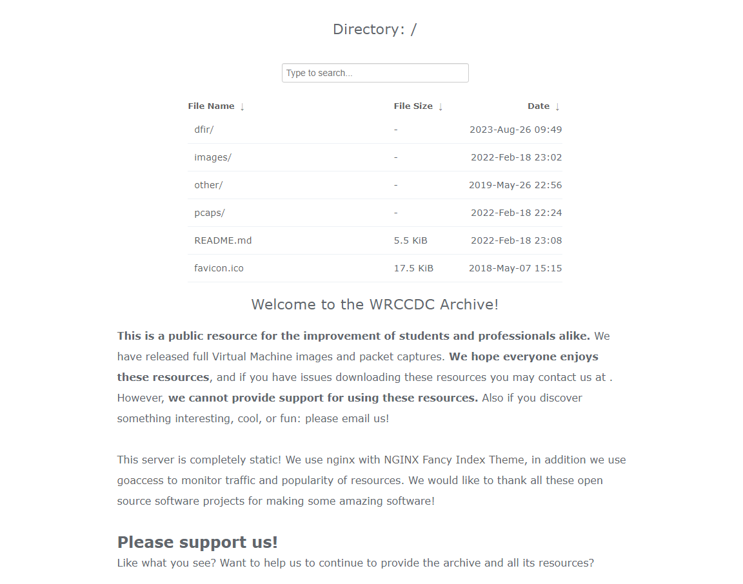
Open Source
https://dfir.wrccdc.org

Slide 50
Open Source
Data is freely available for now in our Timesketch instance
Temporary
Maybe subject to downtime/change (but we’ll try our best)
Long term we’ll be uploading more IR data and making it freely available for research purposes
Hoping to do this annually
Contact michael.glass@wrccdc.org for questions
Or on Twitter/LinkedIn

Slide 51
Thank You!
We hope you liked the presentation
You can ask us questions after the talk at the speaker lounge

